Slide 1
08/12/2014
Takeaway
Eat - In
Quick Food
18:35:36
DINNER
1
2
3
4
5
6
7
8
9
10
STAFF8
11
12
13
14
15
16
17
18
19
20
Table
Status
21
22
23
24
25
26
27
28
29
30
31
32
33
34
35
36
37
38
39
40
Table
Booking
Show
Order
-
-
-
-
-
-
-
-
-
-
-
-
-
-
-
-
-
-
-
-
Control
Panel
-
-
-
-
-
-
-
-
-
-
-
-
-
-
-
-
-
-
-
-
Logout
RESERVED
Eating
Billed & Unpaid
Being Processed
Paid & Eating
Empty
VIP

Slide 2
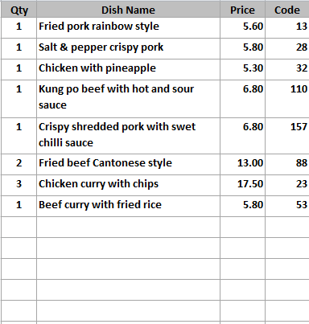
3
Table 2
Mixed hot platter
Mixed hot platter
Mixed hot platter
Mixed hot platter
Duck spring rolls
Duck spring rolls
Duck spring rolls
Duck spring rolls
Beef ginger and
spring onion
Beef ginger and
spring onion
Beef ginger and
spring onion
Beef ginger and
spring onion
Chicken yellow bean
cashew nuts
Chicken yellow bean
cashew nuts
Chicken yellow bean
cashew nuts
Chicken yellow bean
cashew nuts
MENU 1
Roast
Pork
Roast
Pork
Roast
Pork
Roast
Pork
Roast
Pork
SEARCH
MEAL
Szechuan
Szechuan
Szechuan
Szechuan
Szechuan
LANGUAGE
BBQ
Sauce
BBQ
Sauce
BBQ
Sauce
BBQ
Sauce
BBQ
Sauce
11
£67.95
18:48:30
86
+
-
REMOVE
ITEM
123
COURSE
Tomato
Tomato
Tomato
Tomato
Tomato
ORDER
CONTROL
FOOD
REMARK
+ / -
COURSE
DIVIDER
KEYPAD
Foo
Yung
Foo
Yung
Foo
Yung
Foo
Yung
Foo
Yung
PRINT
ORDER
TABLE FOOD
CHANGE
PAYMENT
CANCEL
ORDER
Tray Meal
Tray Meal
Tray Meal
Tray Meal
Tray Meal
Desktop
EXIT
ACCEPT
Tray Meal
Tray Meal
Tray Meal
Tray Meal
Tray Meal

Slide 3
Control Panel
System Setting
System
Configuration
User
Maintenance
Data Manager
Compact
Database
Computer
Address
Shift Code
Takeaway & Quick Dining Setting
Takeaway
Configuration
Menu Category
Menu Item
Manage
Menu Set
Extra Menu
Edit
Order Control
Department
Code
Table Setup
Print Setup
Caller
Record
Eat In Setting
Eat-In
Configuration
Menu Category
Menu Item
Manage
Menu Set
Extra Menu
Edit
Order Control
Department
Code
Table Setup
Printer
Order Entry
Print Setup
Reporting
Account
Summary
Reports
System
Control
Exit

Slide 4
Eat In Configuration
General Setting
Till Number is the ID of the computer, if a network has three computers, it will be 1,2 and 3
Back Up When Exit – if exit software will back up business and menu database to the drive specified
Auto Exit After Print Bill – exit to the table layout page after print bill
Will logout the user if inactive after certain period of time
Payment Type and Surcharges
Payment Type
Surcharge Threshold
Surcharge Amount
Surcharge %
Auto Discount %
10
Cash
0.00
0.00
Auto Discount Threshold
20
Debit Card
10.00
5
Service Charges Setting
Credit Card
0.00
1.00
0.00
Cheque
0.00
Enable Service Charge
0.00
SC before discount
Service Charge %
10
Others
Menu Display Font
No. of People apply SC
2
Menu Dish Button Font Size
9
Service Charge Wording
Auto Exit After Print Bill
Service Charge @ 10%
Auto Logout Timer
5
Menu Dish Code Font Bold
Category Button Font Size
9
Category Button Font Bold
Save
Exit

Slide 5
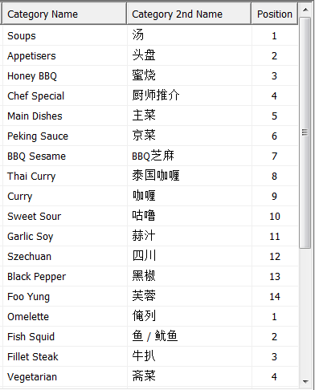
Eat In Menu Category
Menu Set
Chinese
Happy
Meal
3
4
Category
Name in English
Curry
Other Name
咖哩
Display Position
61
Department Code
Department Code
KIT
Add
New
Copy
Delete
Save
Exit

Slide 6
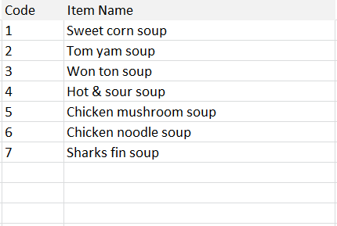
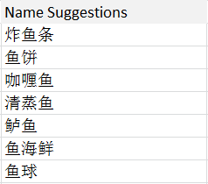


Menu Item
Dish Attributes
Second Choices
Third Choices
Taste Handling
Sub Menu
Printer Name – can print according to department code or force to print on a printer
Print Order – X means do not print
Ingredient – will selected will appear on the sub line.
Menu Set
Dish Code
98
Button Colour
Chinese
Happy
Meal
3
4
Display Position
98
Supply Shift
All Day
English Name
Dish code search
Dish category search
Chicken mushroom
Dish Code
61
Search
Soup
Printer Name
By Dept
Other Name
蘑菇雞
Print Order
X
Kitchen Description
Search Other Name
蘑菇雞跟人蔘菇
Dish Name
Fish
Search
Large Regular Small
Copy
5.0
3.5
2.5
Special Promo Prices
Large Regular Small
4.00
3.20
2.20
Menu Category
Unavailable
Discountable
Without VAT
Supply Day
Add
New
Copy
Delete
Save
Exit

Slide 7
Menu Item
Enable Choices – once enabled will pop up another window after the dish is selected
Copy Choices – copy second choices from another dish, save time doing it from zero
Dish Attributes
Second Choices
Third Choices
Taste Handling
Sub Menu
Menu Set
Chinese
Happy
Meal
3
4
Enable Choices
Copy Choices
English Name
Other Name
Add.
Price
Auto Append
Dish code search
Dish category search
Mushroom
蘑菇
1.50
Dish Code
61
Search
Soup
Chinese leaf
紹菜
1.50
Aubergine
茄子
1.50
Mooli
蘿蔔
1.50
Needle mushroom
金針菇
1.50
Kai Lan
芥蘭
1.50
Pak Choi
白菜
1.50
Add
New
Copy
Delete
Save
Exit

Slide 8
Menu Item
Dish Attributes
Second Choices
Third Choices
Taste Handling
Sub Menu
Menu Set
Chinese
Happy
Meal
3
4
Enable Choices
Copy Choices
English Name
Other Name
Add. Price
Auto Append
Dish code search
Dish category search
Fried Rice
炒飯
0.50
Dish Code
61
Search
Soup
Boiled Rice
白飯
0.00
Chips
薯條
0.00
Add
New
Copy
Delete
Save
Exit

Slide 9
Menu Item
Dish Attributes
Second Choices
Third Choices
Taste Handling
Sub Menu
Menu Set
Chinese
Happy
Meal
3
4
Enable Choices
Copy Choices
English Name
Other Name
Add. Price
Dish code search
Dish category search
More king prawn
多大虾
2.50
Dish Code
61
Search
Soup
Less mushroom
少蘑菇
0.00
Less Chilli
少辣
0.00
Extra beef
多牛肉
2.00
Extra MSG
多味精
1.00
No Szechuan sauce
不要四川汁
0.00
No peanuts
不要花生
0.00
Less salt
少咸
0.00
Add straw
加饮管
0.00
More ice
多冰
0.00
Add
New
Copy
Delete
Save
Exit

Slide 10

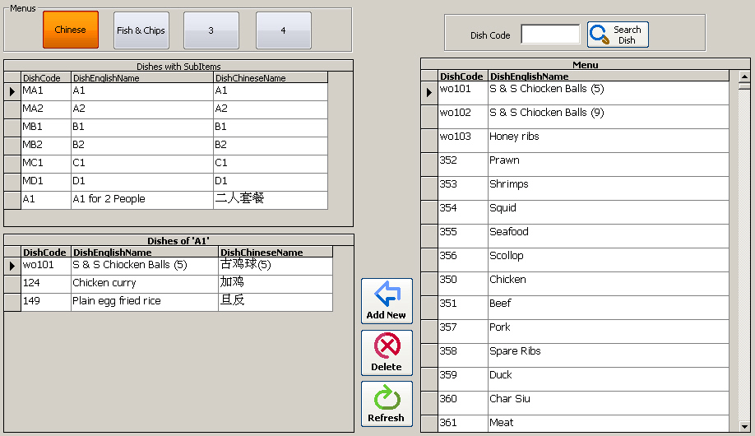
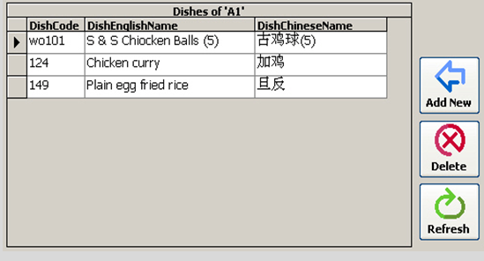

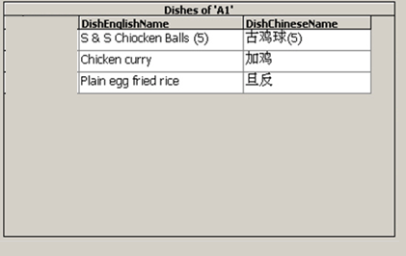

Menu Item
Dish Attributes
Second Choices
Third Choices
Taste Handling
Sub Menu
Defines the dish content of a set meal
Auto Expand
Save
Exit

Slide 11
Manage Menu Set
Menu Set
Chinese
Happy
Meal
3
4
Names of Menu Set
English Name
Other Name
Chinese
中國餐
Delete Menu Content
Happy Meal
快樂餐
Delete Menu Content
3
3
Delete Menu Content
4
4
Delete Menu Content
Copy Menu Content
From
Takeaway
Chinese
Copy
To
Eat-In
4
Save
Exit

Slide 12
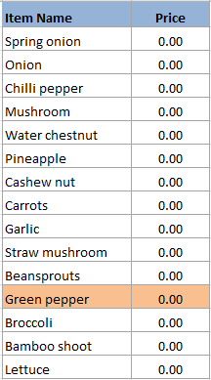
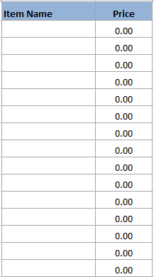
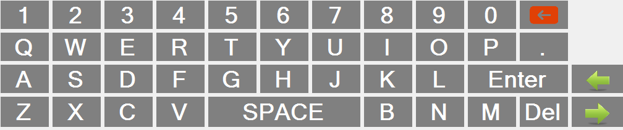
Extra Menu Edit
Button Name
Taste Item
Drink Item
Vegetable
Edit Item
Vegetable
English Name
Green Pepper
Vegetable 2
Other Name
Bean
青椒
Price
Meat
1.50
Seafood
Display Position
2
Sauce
Add
New
Save
Cancel
Taste
Fruit
Cooking
Others
Exit

Slide 13
Order Control
Cook when told
Cook now
As starter
As 2nd course
As main course
Hurry please cook
Missing pls cook
Cancel order
Sauce separate
With desserts
Split 2 plates
Split 3 plates
All separate
As takeaway
Cook first
Smaller portion
Edit Item
English Name
Split 3 plates
Save
Cancel
Other Name
分開三碟上
Exit

Slide 14
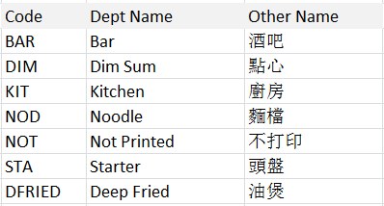
Department Code Entry
Department Code List
Department Code Content Input
Define the printer for a department, number of copies
Print Dishes Separately – is to print one dish per one tiny paper
Dept. Code
KIT
Dept Name
Kitchen
Other Name
廚房
Printer Assignment
OK
Printer Name
Epson TM-88
Number of Copy
2
Print Dishes Separately
Add
New
Copy
Delete
Save
Exit

Slide 15
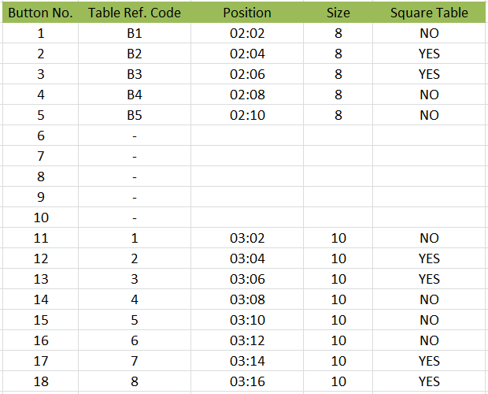
Table Set Up
Table Assignment
Define the shape, the position of the table button on the table map and table size
Save
Exit

Slide 16
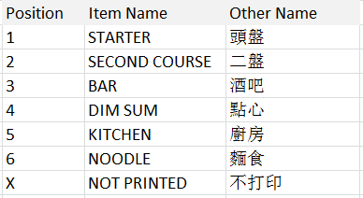
Print Order Entry
Define the printing sequence on the customer bill
Position List
Position Input
Display Position
1
English Name
Starter
Other Name
頭盤
OK
Add
New
Copy
Delete
Save
Exit

Slide 17
Print Setup
Local Setting
Receipt Setting
Kitchen Setting
Print Order Number will only show up when pressing CTRL F11
Universal Print Options
Print Information
Print Logo
Telephone No.
01206 888 3338
Logo Position
00400
12
VAT No.
82334 123478
Auto Print to Dept.
Message
Thank you please come again
Print Pre Line
3
Message
Easter holiday special meal
Print Post Line
3
Message
Please contact us for details
Local Printer
INV
Message
Please visit our website @
Print Language
Both
Message
www.sunrisebicester.co.uk
English Font Size
Medium
Other Language Font Size
Medium
Print Date
Print Time
Auto Print Order Paper
Print Ref. Number
Print Cancel Item
Print Address
Print Staff Name
Print Telephone
Print Number of Guest
Save
Print VAT Number
Print Table No.
Print Subtotal
Print Order Number
Exit

Slide 18
Print Setup
Local Setting
Receipt Setting
Kitchen Setting
Print Order Number will only show up when pressing CTRL F11
Customer Receipt Printout Settings
Local Printer
INV
Heading Word
Receipt
Heading Font Size
Medium
Print Language
English
English Font Size
Medium
Other Language Font Size
Medium
Print Date
Print Time
Print Table No.
Print Address
Print Telephone
Print VAT No.
Print Payment Type on Bill
Print VAT Calculation
Save
Print Order No.
Exit

Slide 19
Print Setup
Local Setting
Receipt Setting
Kitchen Setting
Print Language
Both
Print Language Separately
Print Price / Dish Code
Price
Print Order Number
English Font Size
Medium
Print Ascending Sorting No.
Other Language Font Size
Medium
Print Date
Print Time
Heading Font Size
Medium
Print Pre Line
3
Print Post Line
3
Print Price or Dish Code
Price
Save
Exit

Slide 20
END
(Slides beyond this page are for references only)

